Slide 1
The main constituents of Earth’s atmosphere are nitrogen ($N_{2}$) and oxygen ($O_{2}$)

Slide 2
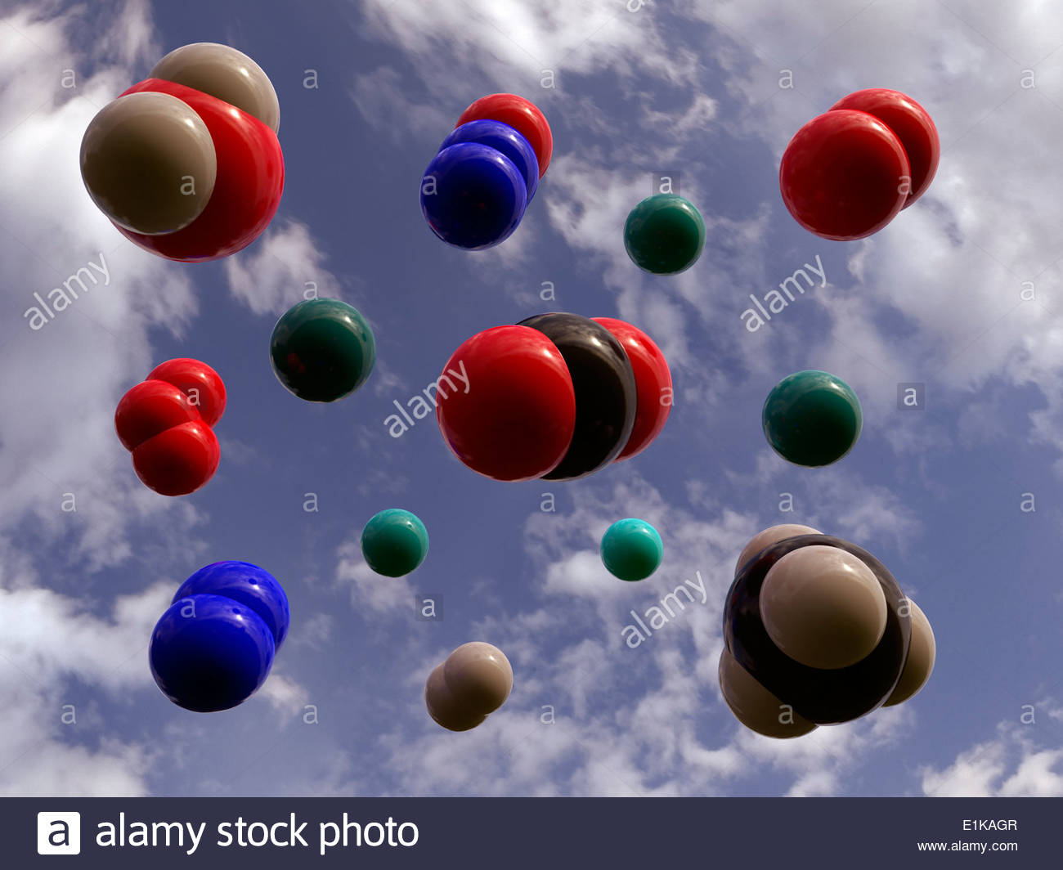
Main constituents
Main constituents:
Nitrogen (N₂)
Oxygen (O₂)

Slide 3
Main constituents
Main constituents:
Nitrogen (N₂)
Oxygen (O₂)

Slide 4
Main constituents
Main constituents:
Nitrogen (N₂)
Oxygen (O₂)

Slide 5
Secondary gases / Trace gases

Slide 6
Secondary/trace gases: can you match images to names (and formulas)?
Secondary:
Water vapor (H₂O)
Argon (Ar)
Trace amounts:
Carbon dioxide (CO₂)
Nitrous oxide (N₂O)
Methane (CH₄)
Ozone (O₃)

Slide 7
Secondary/trace gases: can you match images to names (and formulas)?
Secondary:
Water vapor (H₂O)
Argon (Ar)
Trace amounts:
Carbon dioxide (CO₂)
Nitrous oxide (N₂O)
Methane (CH₄)
Ozone (O₃)

Slide 8
Secondary/trace gases: can you match images to names (and formulas)?
Secondary:
Water vapor (H₂O)
Argon (Ar)
Trace amounts:
Carbon dioxide (CO₂)
Nitrous oxide (N₂O)
Methane (CH₄)
Ozone (O₃)

Slide 9
Secondary/trace gases: can you match images to names (and formulas)?
Secondary:
Water vapor (H₂O)
Argon (Ar)
Trace amounts:
Carbon dioxide (CO₂)
Nitrous oxide (N₂O)
Methane (CH₄)
Ozone (O₃)

Slide 10
Secondary/trace gases: can you match images to names (and formulas)?
Secondary:
Water vapor (H₂O)
Argon (Ar)
Trace amounts:
Carbon dioxide (CO₂)
Nitrous oxide (N₂O)
Methane (CH₄)
Ozone (O₃)

Slide 11
Secondary/trace gases: can you match images to names (and formulas)?
Secondary:
Water vapor (H₂O)
Argon (Ar)
Trace amounts:
Carbon dioxide (CO₂)
Nitrous oxide (N₂O)
Methane (CH₄)
Ozone (O₃)

Slide 12
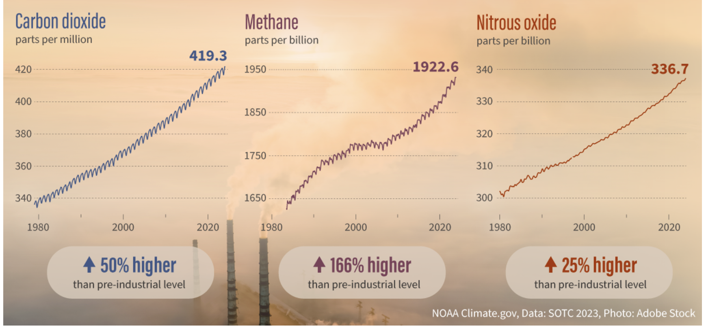
Trace gas concentrations are reported in “parts per million,” “parts per billion,” etc.
According to this 2023 table from NOAA:
CO₂: 419 ppm => There were 419 CO₂ molecules for every million air molecules (now 428.5)
CH₄: 1922 ppb => There were 1922 CH₄ molecules for every billion air molecules – which means not quite two CH₄ molecules for every million (1922 ppb = 1.9 ppm)
N₂O: 336 ppb => There were 336 N₂O molecules for every billion air molecules (336 ppb = 0.3 ppm)

Slide 13
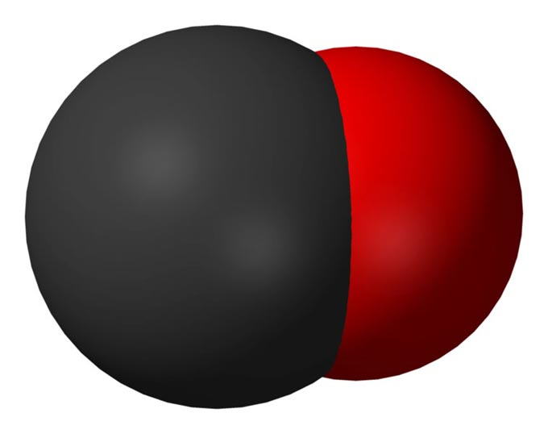
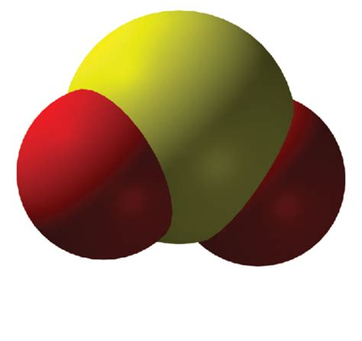
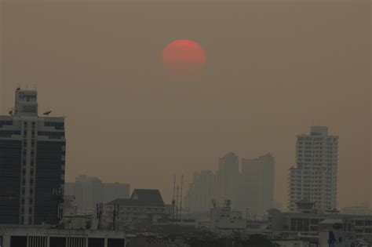
Also in the air close to the ground: “air pollution”
Noxious (poisonous) gases you can’t see
CO (Carbon Monoxide)
SO₂ (Sulfur dioxide)
Aerosols (you can see these)
Particulate matter (PM2.5, PM10)
Sulfates (SO4)

